Slide 1
Performance Metrics
for Parallel Systems

Slide 2
Performance Metrics for Parallel Systems
It is important to study the performance of parallel programs with a view to determining the best algorithm, evaluating hardware platforms, and examining the benefits from parallelism. A number of metrics have been used based on the desired outcome of performance analysis.

Slide 3
Execution Time
The serial runtime of a program is the time elapsed between the beginning and the end of its execution on a sequential computer. We denote the serial runtime by T_{S.}
The parallel runtime is the time that elapses from the moment a parallel computation starts to the moment the last processing element finishes execution. We denote parallel runtime by T_{P}.
Total runtime for parallel computing is denoted by TR, where TR=p x T_{P}

Slide 4
Total Parallel Overhead
The overheads incurred by a parallel program are encapsulated into a single expression referred to as the overhead function. We define overhead function or total overhead of a parallel system as the total time collectively spent by all the processing elements over and above that required by the fastest known sequential algorithm for solving the same problem on a single processing element. We denote the overhead function of a parallel system by the symbol T_{o}.
The total time spent in solving a problem summed over all processing elements is pT_{P} . T_{S} units of this time are spent performing useful work, and the remainder is overhead. Therefore, the overhead function (T_{o}) is given by

Slide 5

What is overhead?
The process elements stop executing and start doing unnecessary tasks. Types of overhead:
Inter process
communication
1 2 3 4
A B C D

Slide 6
Idling
90% 10%
A B

Slide 7
Excess Computing
A B C D
1
2
3
1
5
4
4
2
1
3
5
2

Slide 8
Speedup
When evaluating a parallel system, we are often interested in knowing how much performance gain is achieved by parallelizing a given application over a sequential implementation. Speedup is a measure that captures the relative benefit of solving a problem in parallel. It is defined as the ratio of the time taken to solve a problem on a single processing element to the time required to solve the same problem on a parallel computer with p identical processing elements. We denote speedup by the symbol S.
S= T_{S} /T_{p}

Slide 9
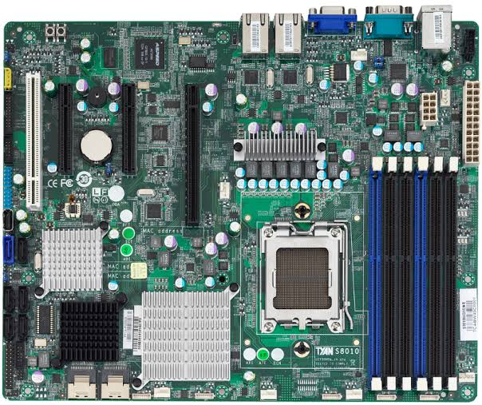
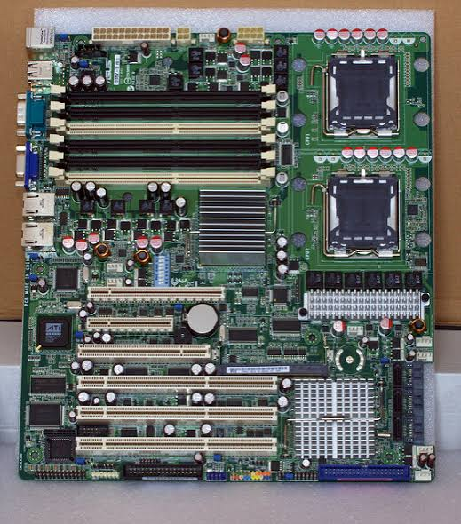
Single Processor
Multi(p) Processors

Slide 10

Efficiency
Only an ideal parallel system containing p processing elements can deliver a speedup equal to p. In practice, ideal behavior is not achieved because while executing a parallel algorithm, the processing elements cannot devote 100% of their time to the computations of the algorithm. As we saw in Example 5.1, part of the time required by the processing elements to compute the sum of n numbers is spent idling (and communicating in real systems). Efficiency is a measure of the fraction of time for which a processing element is usefully employed; it is defined as the ratio of speedup to the number of processing elements. In an ideal parallel system, speedup is equal to p and efficiency is equal to one. In practice, speedup is less than p and efficiency is between zero and one, depending on the effectiveness with which the processing elements are utilized. We denote efficiency by the symbol E. Mathematically, it is given by

Slide 11
Cost
We define the cost of solving a problem on a parallel system as the product of parallel runtime and the number of processing elements used. Cost reflects the sum of the time that each processing element spends solving the problem. Efficiency can also be expressed as the ratio of the execution time of the fastest known sequential algorithm for solving a problem to the cost of solving the same problem on p processing elements.
The cost of solving a problem on a single processing element is the execution time of the fastest known sequential algorithm. A parallel system is said to be cost-optimal if the cost of solving a problem on a parallel computer has the same asymptotic growth (in Q terms) as a function of the input size as the fastest-known sequential algorithm on a single processing element. Since efficiency is the ratio of sequential cost to parallel cost, a cost-optimal parallel system has an efficiency of Q(1).
Cost is sometimes referred to as work or processor-time product, and a cost-optimal system is also known as a pT_{P} -optimal system.

